Slide 1
JENKINS
Table of contents
What is Jenkins
What is Continuous Integration(CI)
What is Continuous Delivery (CD)?
Difference between CI and CD
Development without CI vs. Development with CI
How Continuous integration work?
How does Jenkins work?
Why use Continuous Integration with Jenkins?
Before Jenkins v After Jenkins
Jenkins Plugins

Slide 2
What is Jenkins?
Jenkins is an open-source Continuous Integration server written in Java to put together a chain of actions to achieve the Continuous Integration process .
Jenkins supports the complete development life cycle of software from building, testing, documenting the software, deploying, and other stages of the SDLC.
The principle functionality of Jenkins is to keep a track of version control system and to initiate and monitor a build system if changes occur.
It monitors the whole process and provides reports and notifications to alert.
The reason Jenkins software became so popular is that of its monitoring of repeated tasks which arise during the development of a project.
For example, if your team is developing a project, Jenkins will continuously test your project builds and show you the errors in early stages of your development.

Slide 3
What is Continuous Integration?
Continuous Integration is a process of integrating code changes from multiple developers in a single project many times.
The software is tested immediately after a code commit. With each code commit, code is built and tested.
If the test is passed, the build is tested for deployment.
If the deployment is successful, the code is pushed to production.
This commit, build, test, and deploy is a continuous process and hence the name continuous integration/deployment.
In Continuous Integration after a code commit, the software is built and tested immediately. In a large project with many developers, commits are made many times during a day. With each commit code is built and tested. If the test is passed, build is tested for deployment. If the deployment is a success, the code is pushed to Production. This commit, build, test, and deploy is a continuous process, and hence the name continuous integration/deployment.

Slide 4
What is Continuous Delivery (CD)?
Continuous Delivery is a software engineering method in which a team develops software products in a short cycle. It ensures that software can be easily released at any time. The main aim of continuous delivery is to build, test, and release software with good speed and frequency. It helps you to reduce the cost, time, and risk of delivering changes by allowing for frequent updates in production.
Difference between CI and CD
Continuous Integration (CI) is an approach of testing each change to codebase automatically, whereas Continuous Delivery (CD) is an approach to obtain changes of new features, configuration, and bug fixes.

Slide 5
Development without CI vs Development with CI
Here are key differences between development using CI or without CI:
Development without CI | Development with CI
Lots of Bugs | Fewer bugs
Infrequent commits | Regular commits
Infrequent and slow releases | Regular working releases
Difficult integration | Easy and Effective Integration
Testing happens late | Continuous Integration testing happens early and often.
Issue raised are harder to fix | Find and fix problems faster and more efficiently.
Poor project visibility | Better project visibility

Slide 6
How Continuous integration work?
You are surely aware of the old phone Nokia. Nokia used to implement a procedure called nightly build.
After multiple commits from diverse developers during the day, the software built every night.
Since the software was built only once in a day, it’s a huge pain to isolate, identify, and fix the errors in a large codebase.
Later, they adopted the Continuous Integration approach.
The software was built and tested as soon as a developer committed code.
If any error is detected, the respective developer can quickly fix the defect.

Slide 7
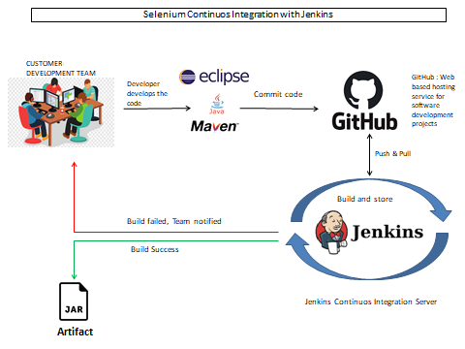

Slide 8
How does Jenkins work?
Jenkins is a server-based application and requires a web server like Apache Tomcat to run on various platforms like Windows, Linux, macOS, Unix, etc.
To use Jenkins, you need to create pipelines which are a series of steps that a Jenkins server will take. Jenkins Continuous Integration Pipeline is a powerful instrument that consists of a set of tools designed to host, monitor, compile and test code, or code changes, like:
Continuous Integration Server (Jenkins, Bamboo, CruiseControl, TeamCity, and others)
Source Control Tool (e.g., CVS, SVN, GIT, Mercurial, Perforce, Clear Case and others)
Build tool (Make, ANT, Maven, Ivy, Gradle, and others)
Automation testing framework (Selenium, Appium, TestComplete, UFT, and others)

Slide 9
Some people might think that the old-fashioned way of developing the software is the better way. Let’s understand the advantages of CI with Jenkins with the following example Let us imagine, that there are around 10 developers who are working on a shared repository.Some developer completes their task in 25 days while others take 30 days to complete.
Why use Continuous Integration with Jenkins?
Before Jenkins
Once all Developers had completed their assigned coding tasks, they used to commit their code all at same time. Later, Build is tested and deployed.
Code commit built, and test cycle was very infrequent, and a single build was done after many days.
Since the code was built all at once, some developers would need to wait until other developers finish coding to check their build.
It is not an easy task to isolate, detect, and fix errors for multiple commits.
Code build and test process are entirely manual, so there are a lot of chances for failure.
The code is deployed once all the errors are fixed and tested.
Development Cycle is slow
After Jenkins
The code is built and test as soon as Developer commits code. Jenkin will build and test code many times during the day
If the build is successful, then Jenkins will deploy the source into the test server and notifies the deployment team.
If the build fails, then Jenkins will notify the errors to the developer team.
The code is built immediately after any of the Developer commits.
Since the code is built after each commit of a single developer, it’s easy to detect whose code caused the built to fail
Automated build and test process saving timing and reducing defects.
The code is deployed after every successful build and test.
The development cycle is fast. New features are more readily available to users.

Slide 10
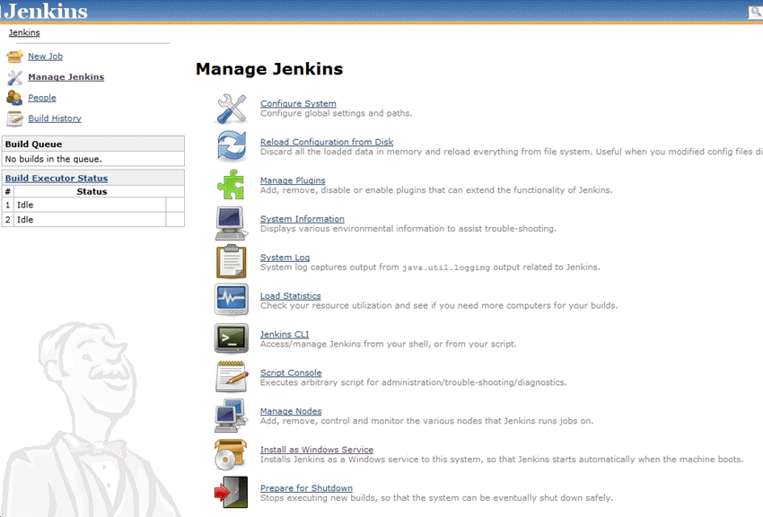
Jenkins Plugins
By default, Jenkins comes with a limited set of features. If you want to integrate your Jenkins installation with version control tools like Git, then you need to install plugins related to Git. In fact, for integration with tools like Maven, Amazon EC2, you need to install respective plugins in your Jenkins.

Slide 11
In Continuous Integration, after a code commit, the software is built and tested immediately
Jenkins used for orchestrating a chain of actions for Continuous Integration in a software project
Before Jenkins when all Developers had completed their assigned coding tasks, they used to commit their code all at same time. Later, Build is tested and deployed.
After Jenkins the code is built and test as soon as Developer commits code. Jenkin will build and test code many times during the day
By default, Jenkins comes with a limited set of features. If you want to integrate your Jenkins installation with version control tools like Git, then you need to install plugins related to Git
The biggest pros of Jenkins is that it is managed by the community which holds public meetings and take inputs from the public for the development of Jenkins projects
The biggest con of Jenkin is that Its interface is out dated and not user friendly compared to current UI trends.

